Slide 1
Boolean Algebra & Logic Gates:

Slide 2
BASIC GATES
Logic gates are abstractions of electronic circuit components that operate on one or more input signals to produce an output signal.

Slide 3
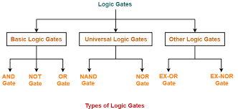
Logic Gates

Slide 4
Basic Logic Gates
Logic gates are abstractions of electronic circuit components that operate on one or more input signals to produce an output signal.
2-Input AND
2-Input OR
NOT (Inverter)
A
A
F
G
A
H
B
B
H = A’
F = A•B
G = A+B

Slide 5
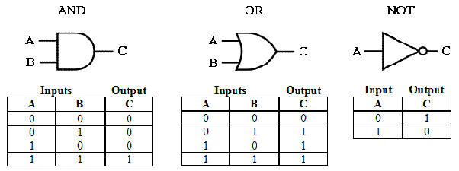
Basic Gates

Slide 6
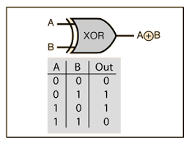
XOR GATE

Slide 7
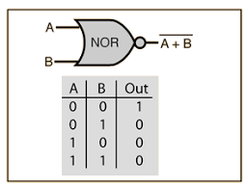
NOR Gate

Slide 8
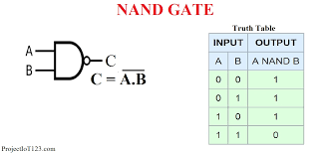
NAND Gate

Slide 9
Why NAND and NOR Universal gate?
The NAND & NOR gates are called universal gates because they perform all the logical operations of basis gates like AND, OR, NOT

Slide 10
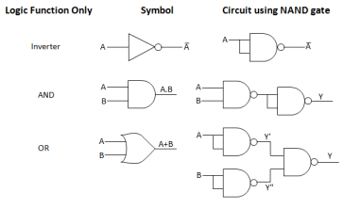
NAND as a Universal Gate

Slide 11
What is boolean algebra
Boolean Algebra is used to analyze and simplify the digital (logic) circuits. It uses only the binary numbers i.e. 0 and 1. It is also called as Binary Algebra or logical Algebra. Boolean algebra was invented by George Boole in 1854.

Slide 12
Rule in Boolean Algebra
Following are the important rules used in Boolean algebra.
Variable used can have only two values. Binary 1 for HIGH and Binary 0 for LOW.
Complement of a variable is represented by an overbar (-). Thus, complement of variable B is represented as . Thus if B = 0 then = 1 and B = 1 then = 0.
ORing of the variables is represented by a plus (+) sign between them. For example ORing of A, B, C is represented as A + B + C.
Logical ANDing of the two or more variable is represented by writing a dot between them such as A.B.C. Sometime the dot may be omitted like ABC.

Slide 13
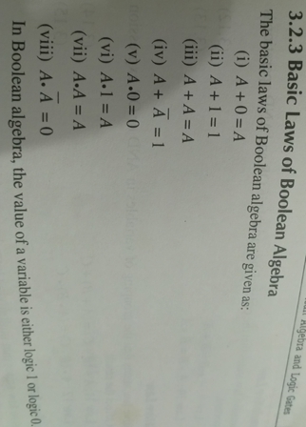
Basic laws of Boolean Algebra

Slide 14
A+ A'=1
A.0=0
A.1=A
A.A=A
A.A‘=0

Slide 15
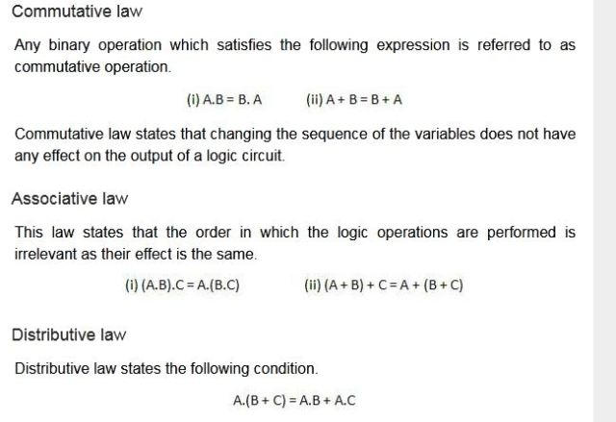
Boolean Theorems

Slide 16
Simplification of boolean expression
Simplify boolean expression using boolean algebra
A+AB=A
L.H.S= A + AB
A(1 +B)
A(1) (1+B=1)
A

Slide 17
Simplify boolean expression using boolean algebra
A(A+B)=A
L.H.S= A(A+B)
= A.A +A.B
= A+A.B
= A(1+B)
=A(1) (1+B=1)
=A

Slide 18
Simplify boolean expression using boolean algebra
A(A' + B)=AB
L.H.S= A(A' + B)
= A. A‘ +A.B
= 0 +AB
=AB=R.H.S

Slide 19
Simplify boolean expression using boolean algebra
AB +AB‘ =A
A(B+B‘)
A(1)
A

Slide 20
(A+B)(A+B‘)=A
AA +AB‘ +AB +BB‘
A + AB‘ +AB + 0
A(1+B‘) +AB
A +AB
A(1+B)
A

Slide 21
Simplify boolean expression using boolean algebra
AB+A‘C +BC =AB +A’C
L.H.S=AB +A’C+BC
=AB +A’C +BC(A +A’) (A+A’=1)
=AB +A’C +ABC + A’BC
=AB +ABC + A’C +A’BC
=AB(1+C) + A’C(1 +B) (1+C=1 & 1+B=1)
=AB + A’C

Slide 22
Simplify boolean expression using boolean algebra
Y(A,B,C,D)=AB’D + AB’D’
=AB’(D+D’)
=AB’(1)
=AB’

Slide 23
Simplify boolean expression using boolean algebra
Y(A,B,C)=ABC +A’B + ABC’
=ABC +ABC’+A’B
=AB(C+C’) +A’B
=AB +A’B (C+C’=1)
= B(A+A’) (A+A’=1)
=B

Slide 24
Simplify boolean expression using boolean algebra
Y(A,B,C,D)=A’B’CD’ +A’B’C’D’
=A’B’D’ (C+C’)
=A’B’D’ (C+C’=1)

Slide 25
De Morgan's Theorems
Theorem 1
The left hand side (LHS) of this theorem represents a NAND gate with inputs A and B, whereas the right hand side (RHS) of the theorem represents an OR gate with inverted inputs.
This OR gate is called as Bubbled OR.

Slide 26

De Morgan's Theorems (Theorem-1)

Slide 27
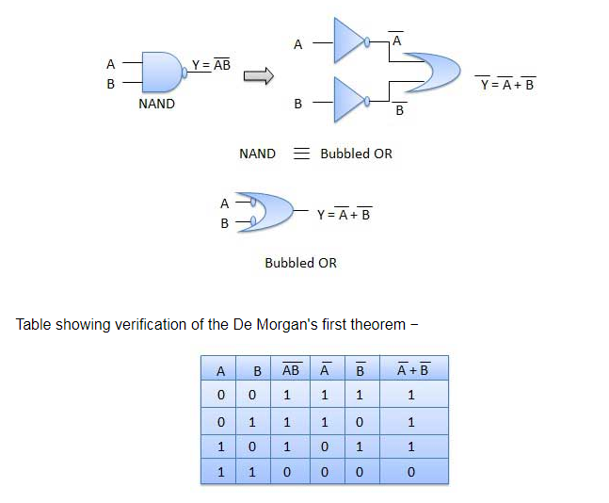
De Morgan's Theorems (Theorem-1)

Slide 28

De Morgan's Theorems (Theorem-2)

Slide 29
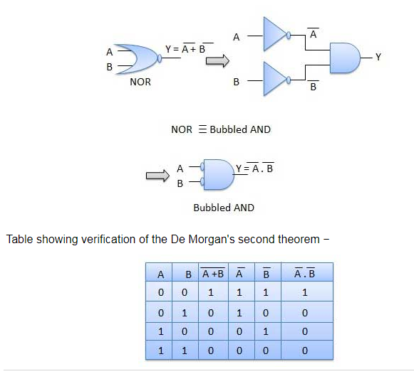
De Morgan's Theorems (Theorem-2)

Slide 30
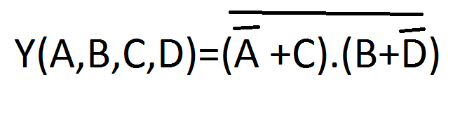

Slide 31
Sum of product form
Sum of product form is a form of expression in Boolean algebra in which different product terms of inputs are being summed together. This product is not arithmetical multiply but it is Boolean logical AND and the Sum is Boolean logical OR.
Y=AB +ABC’ +B

Slide 32
Product of Sum form
Product of Sum expressions are Boolean expressions made up of sums consisting of one or more variables, either in its normal true form or complemented form or combinations of both, which are then AND’ed together
Y(A,B.C)=(A+B’) (A+B+C’)

Slide 33
Canonical and Standard Form
Canonical Form – In Boolean algebra,Boolean function can be expressed as Canonical Disjunctive Normal Form known as minterm and some are expressed as Canonical Conjunctive Normal Form known as maxterm .

Slide 34
Minterm and Maxterm of three variable
Variable |  |  | Minterm | Maxterm
A | B | C
0 | 0 | 0 | A’B’C’=m0 | A+B+C=M0
0 | 0 | 1 | A’B’C=m1 | A+B+C’=M1
0 | 1 | 0 | A’BC’=m2 | A+B’+C=M2
0 | 1 | 1 | A’BC=m3 | A+B’C’=M3
1 | 0 | 0 | AB’C’=m4 | A’+B+C=M4
1 | 0 | 1 | AB’C=m5 | A’+B+C’=M5
1 | 1 | 0 | ABC’=m6 | A’+B’+C=M6
1 | 1 | 1 | ABC=m7 | A’+B’+C’=m7

Slide 35
Standard Form
Standard Form – A Boolean variable can be expressed in either true form or complemented form. In standard form Boolean function will contain all the variables in either true form or complemented form while in canonical number of variables depends on the output of SOP or POS.
Y(A,B,C)= ABC’+AB +B’C
Y(A,B,C)=A’BC +ABC+A’B’C’

Slide 36
Minterm
If each term in the sum of products form contains all the variable (literals), then the expression is known as standard sum of products form or canonical sum of products form, and each individual term in standard sum of product form is called as minterm.
Y=AB +ABC’ +B

Slide 37
Maxterm
If each term of the product of sums contains all the variable (literals), then the expression is known as standard product of sums form or canonical product of sum form, and each individual term in standard product of sums form is called as maxterm.
Y(A,B,C) =(A+B’)(A+B+C’)

Slide 38
Y(A,B,C)=A’B +ABC+ A’C (SOP but not standard sop)
Y(A,B,C)=A’BC +ABC+A’B’C’(standard sop)

Slide 39
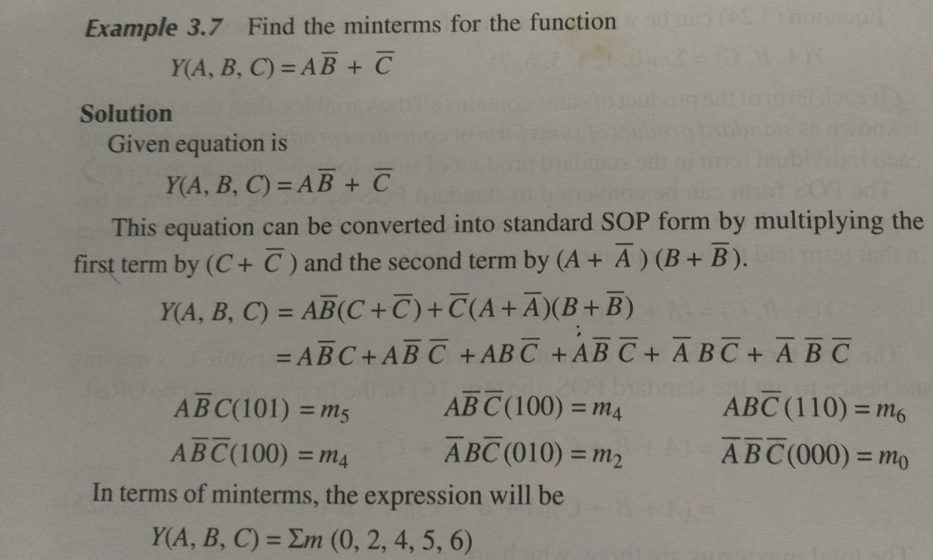

Slide 40
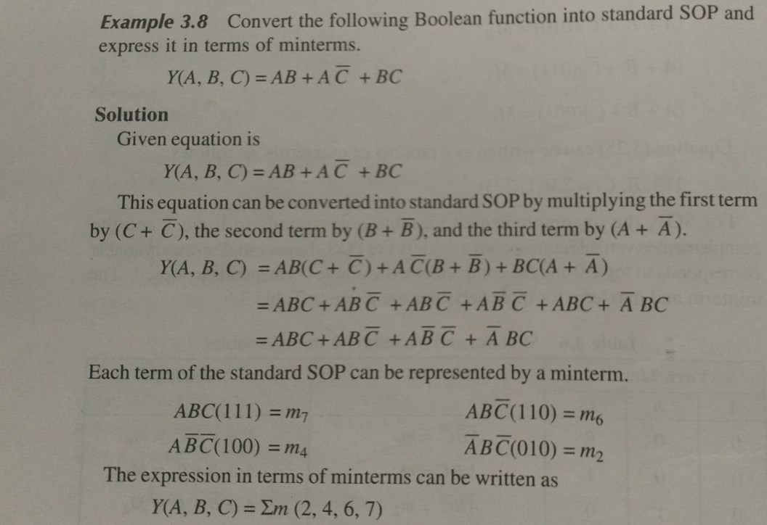

Slide 41
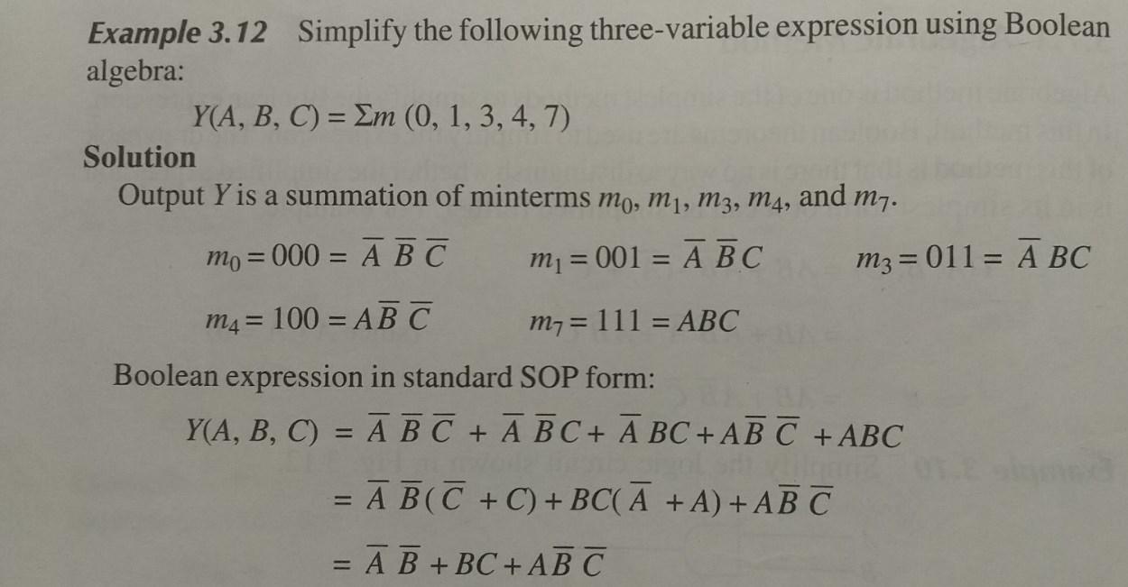

Slide 42
Simplification of Boolean Expression
Algebraic simplification
Karnaugh map method(k-map)
Quine –Mc Cluskey method(Tabulation Method)

Slide 43
Karnaugh map method
This method is known as Karnaugh map method or K-map method. It is a graphical method, which consists of 2^{n} cells for ‘n’ variables. The adjacent cells are differed only in single bit position.

Slide 44
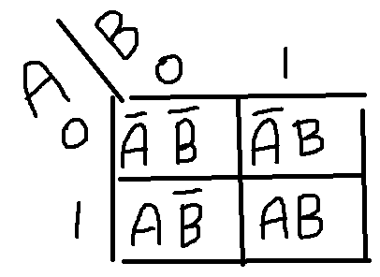
2 Variable K-Map
The number of cells in 2 variable K-map is four, since the number of variables is two. The following figure shows 2 variable K-Map.

Slide 45
Simplify the expression using k-map
Y(A,B)= A’B + AB =B
Y(A,B)=A’B’ +A’B
Y(A,B)=A’B +AB’
Y(A,B)= AB

Slide 46
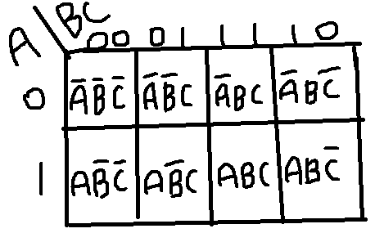
The number of cells in 3 variable K-map is eight, since the number of variables is three. The following figure shows 3 variable K-Map.

Slide 47
Simplify using K-map
(1)F=A’C + A’B + AB’C +BC
(2)F(X,Y,Z)=Σm(0,2,4,5,6)
(3)F(X,Y,Z)=Σm(2,3,6,7)
(4) F(A,B,C)=Σm(0,1,3,4,5,7)

